Slide 1

Shortest path and reach in road networks
Pierre-Elie Belouard & Antoine Oustry
24/01/17

Slide 2
I/ Shortest path tree and main roads
Part 1
Input data reading and graph construction
Dijkstra
Use of a priority queue
Going back
From the vertices between t2 and t2+L (L maximum length of an edge), we go back using the « predecessor array », until our position is less than t1 away from the start point
Use of a flag

Slide 3
A short demo…

Slide 4
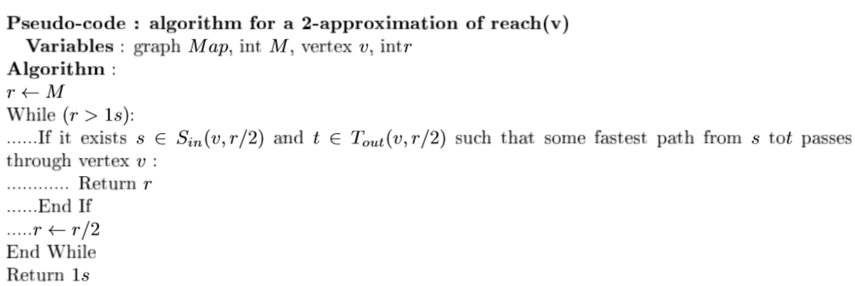
II/ Reach computing
Part 2.B

Slide 5
II/ Reach computing
Analysis of this algorithm
Termination
Loop invariant for correctness : reach(v) ≤ x
Complexity : |V|.|E|.log(|V|)

Slide 6
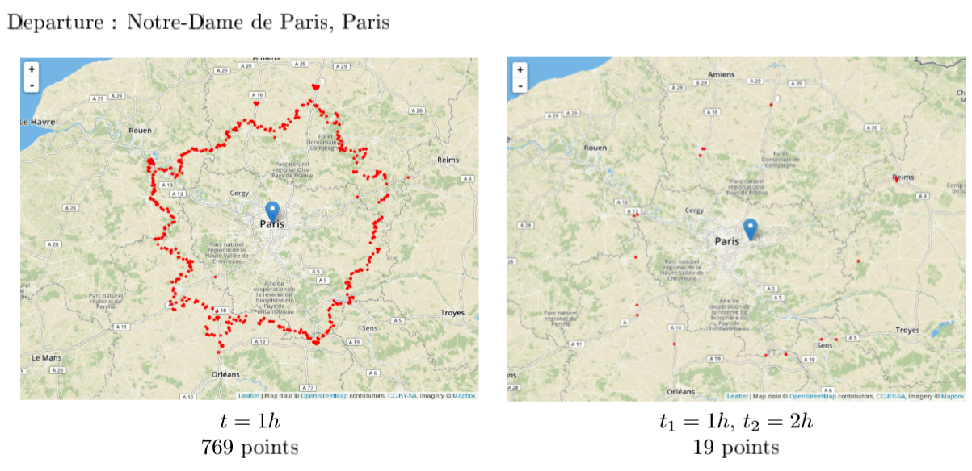
III/ Results
Main roads

Slide 7
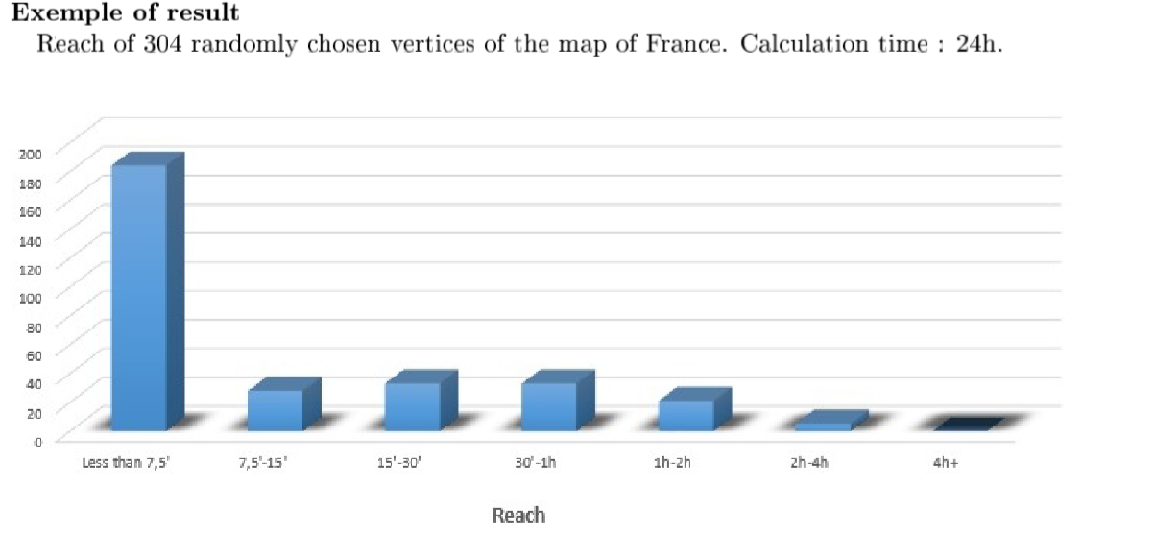
III/ Results
Reach

Slide 8
III/ Results
Reach
During a journey from s to s’, duration T : reach(v)≥min[t(v),T-t(v)]
Possible vertices able to be in the middle of a journey are rarer

